Slide 1
PERSONAL HEALTH INFLUENCERS THROUGH SOCIAL NETWORK- PRESIFIT
PIP104 PROFESSIONAL PRACTICE-II
VIVA-VOCE
Batch Number: G12
Roll Number | Student Name
Under the Supervision of,
Ms. Josephine R
School of Computer Science Engineering & Information Science
Presidency University
Sushruth s 20201CAi0216 Syed Afreen Akther 20201CAI0061 Prathyush S Panicker 20201CAI0079 Akash R 20201CAI00101 Akash V 20201CAI0080

Slide 2
Introduction
"Presifit" is an application introduced for your daily health activities with gamification.
Fostering user motivation and commitment.
Social network that promotes holistic health and wellness, profoundly altering how people interact with each other
Leader Board
Rewards
Focus on Tracking footsteps
Personalized Consultations

Slide 3
Literature Review
Gamification in healthcare is a growing trend, bridging gaps in research and development (SMZLSBM23).
Mobile healthcare apps leverage game features to enhance user engagement (AKS+23).
Smartwatches offer multifaceted support for health and wellness, requiring rigorous field studies for validation (RD16).
A systematic review of 70 million health apps reveals a positive correlation between app ranks and behavior change potential (AOO+22).
Gamified fitness tracker apps emphasize a triad of Social Influence, Competition, and Challenges for sustained use (NHFS21).
A novel smartphone algorithm achieves high precision (93.76%) for walking detection and step counting (KHQ18).

Slide 4
Research Gaps Identified
Gamification
Social networks
Community Events
Health Data Security and Utilization

Slide 5
Proposed Methodology
Needs Assessment and Goal Setting
Personal trainer Consultation
Health plan Tracking
Mental Health Support
Virtual Events
Rewards, Badges and Coupons
Community Engagement and Support
Evaluation and improvement
Marketing and promotion
Partnership and Sponsorship

Slide 6
Objectives
Create a User Centric Social Health Platform
Facilitate Social Connections
Promote Healthy Habits
Encourage Collaborations and Competition
Prioritize Data Privacy and Security
Provide Valuable Insights

Slide 7
System Design & Implementation
Architectural Style
Data Storage and Management
Database Architecture
Data management strategies
Security and compliance

Slide 8
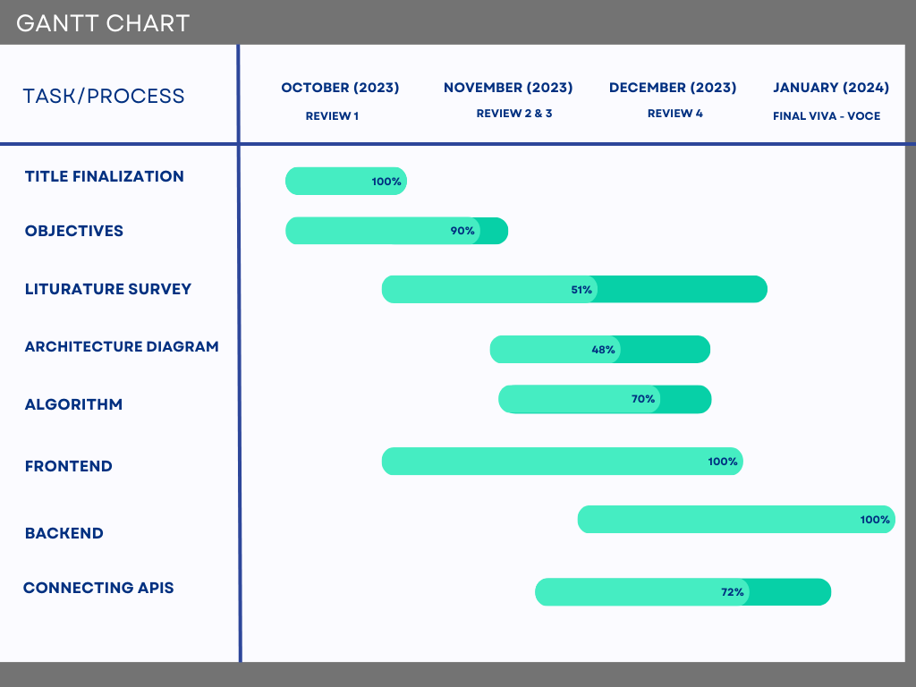
Timeline of Project

Slide 9
Outcomes / Results Obtained
Gamification Boost
Social Synergy
Community pulse
Data with a Conscience
Ripple Effect
Future vision

Slide 10
Conclusion
Gamified health app promotes wellness with rewards.
IHL API integrates gamification for dynamic engagement.
Fusion of challenges and social elements inspires shared health journeys.
Paradigm shift in health apps prioritizing communal well-being.
Strategic gamification catalyzes global lifestyle changes.
Personalized consultation and diet charts
App fosters community, connecting users for shared well-being.
Revolutionizes health, encouraging a connected lifestyle.

Slide 11
References
[AAHAAS23] Ahmad Abadleh, Eshraq Al-Hawari, Esra’a Alkafaween, and Hamad Al-Sawalqah. Step detection algorithm for accurate distance estimation using dynamic step length. 2023.
[AKS+23] Sabahat Ansari, Ridaa Khot, Zaiba Shaikh, Priti Yadav, and Dr. Zainab Pirani. A comprehensive review of gam- ification in healthcare: Incentives in mobile healthcare app. International Research Journal of Engineering and Technology (IRJET), Volume Number(Issue Number):Page Range, 2023.
[AOO+22] Alaa Alslaity, Rita Orji, Oladapo Oyebode, Jonathon Fowles, Darren Steeves, and Banuchitra Suruliraj. Mo- bile applications for health and wellness: A systematic review. Proceedings of the ACM on Human-Computer Interaction, 6, 06 2022.
[DGG23] Priyanka Dawalekar, Namrata Gharat, and Sayali Gaikwad. Data mining techniques for smart fitness. Journal of Information Technology, 2023.
[KHQ18] Xiaomin Kang, Baoqi Huang, and Guodong Qi. A novel walking detection and step counting algorithm using unconstrained smartphones. Sensors, 18(1), 2018.
[NHFS21] Aatish Neupane, Derek Hansen, Jerry Alan Fails, and Anud Sharma. The role of steps and game elements in gamified fitness tracker apps: A systematic review. Multimodal Technologies and Interaction, 5(2), 2021.
[RD16] Blaine Reeder and Alexandria David. Health at hand: A systematic review of smart watch uses for health and wellness. Journal of Biomedical Informatics, 63:269–276, 2016.
[SMZLSBM23] Alfonso D. Gajardo Sa´nchez, Luis R. Murillo-Zamorano, Jose´A´ ngel Lo´pez-Sa´nchez, and Carmen Bueno-Mun˜oz. Gamification in health care management: Systematic review of the literature and research agenda. SAGE Open, 13(4):21582440231218834, 2023.
[SPV20] Vaggelis Saprikis, Marina Pappa, and Maro Vlachopoulou. Gamified mobile apps in health and fitness. 09 2020.
[SVBT18] Dario Salvi, Carmelo Velardo, Jamieson Brynes, and L. Tarassenko. An optimised algorithm for accurate steps counting from smart-phone accelerometry. volume 2018, pages 4423–4427, 07 2018.
[YC22] Jun Ye and Haibo Cao. Application of smart wearable fitness equipment and smart health management based on the improved algorithm. Computational Intelligence and Neuroscience, 2022:1654460, 2022.

Slide 12
Publication Details
International Journal of creative research thoughts | Issn: 2320 – 2882
Paper Id : ICRT2401066
Registration Id: 248863

Slide 13

Thank You

